Slide 1
INFO-3142
Getting Started

Slide 2
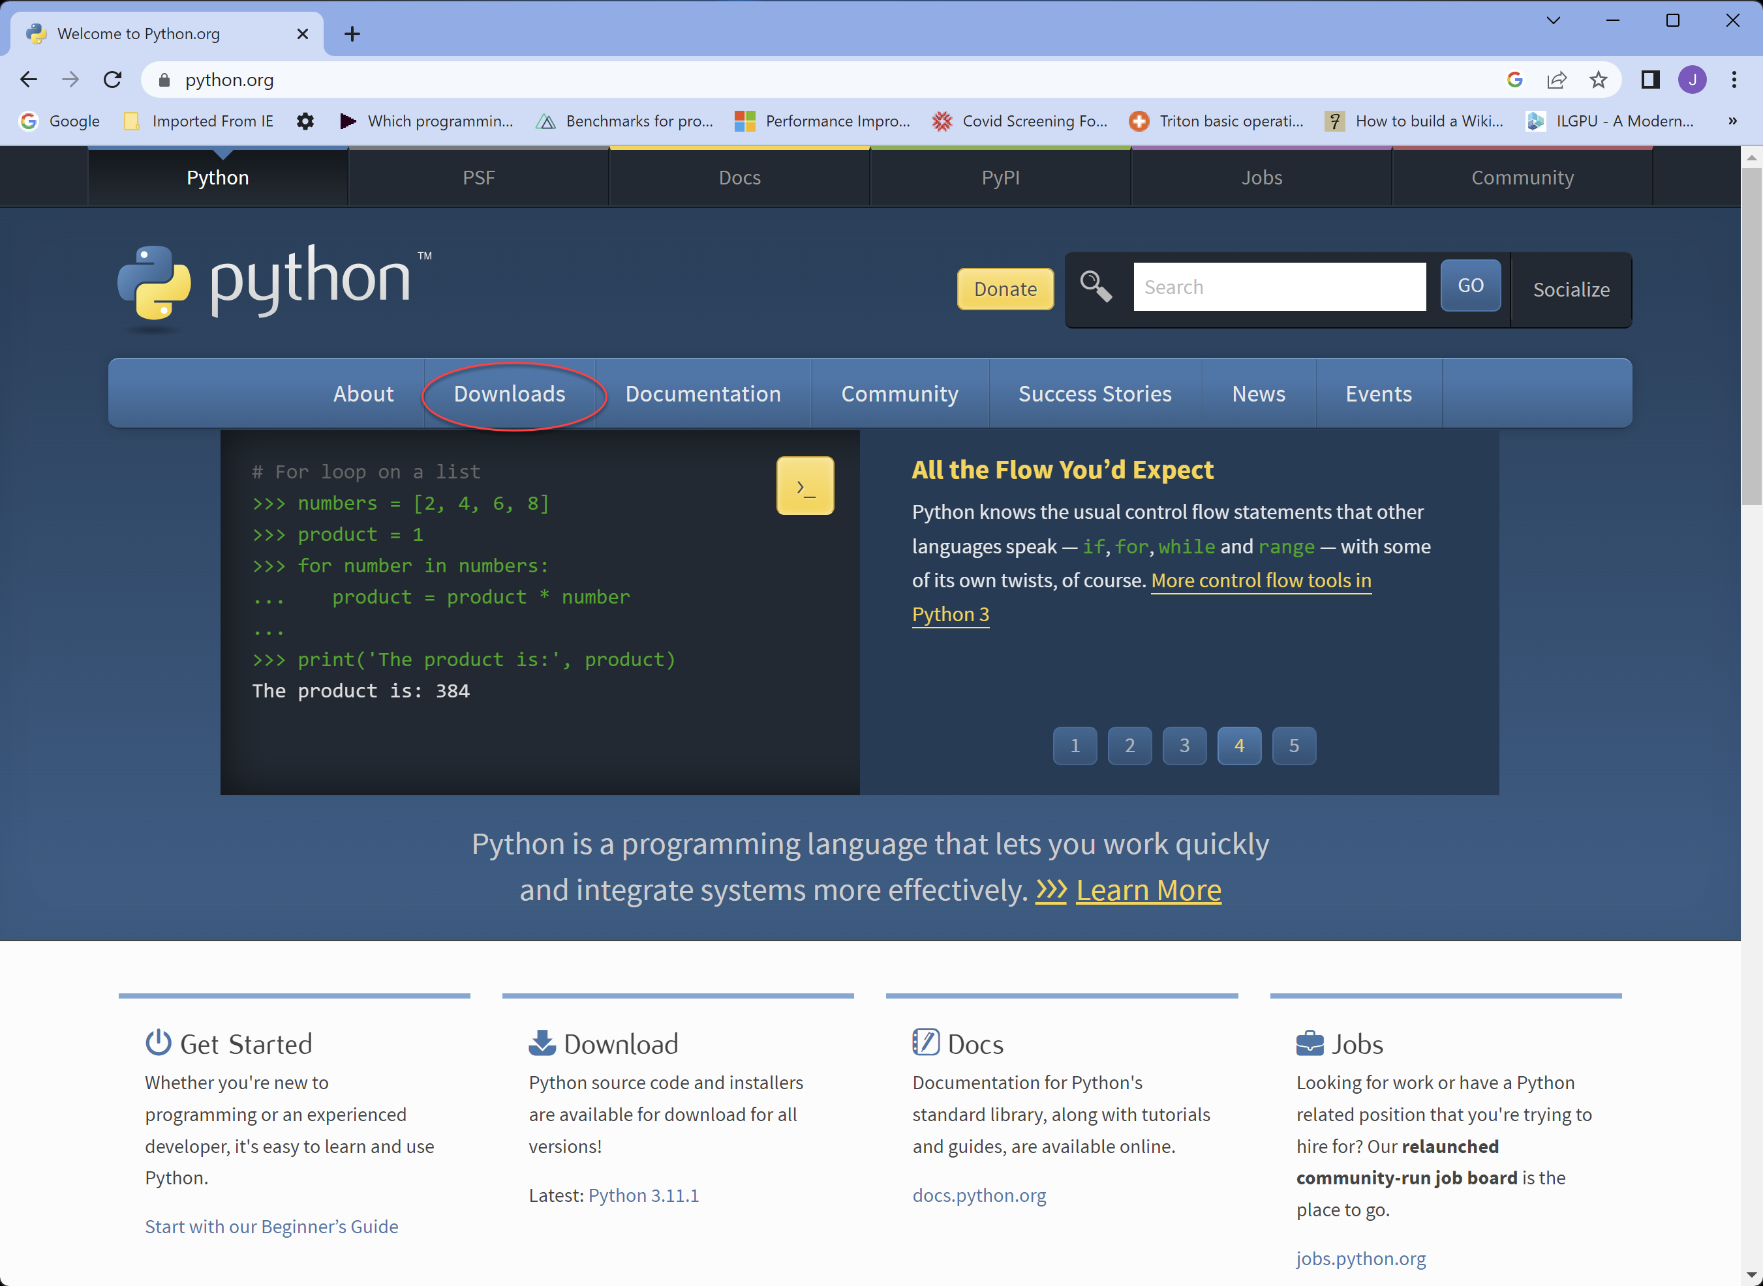
Installing Python

Slide 3
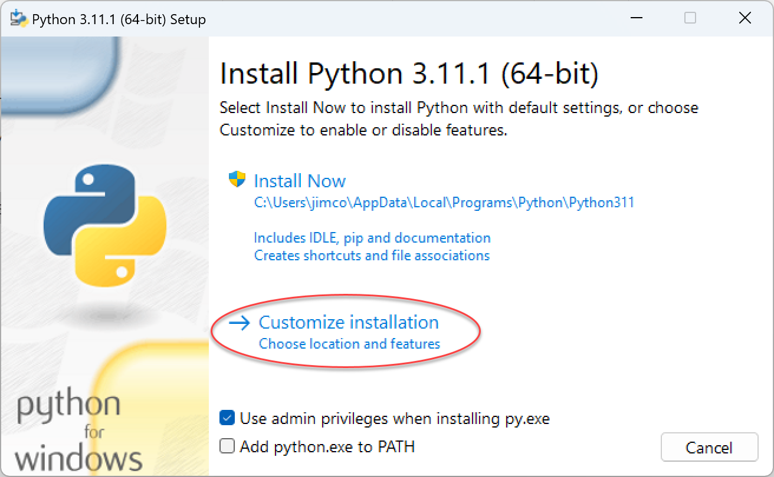
Installing Python

Slide 4
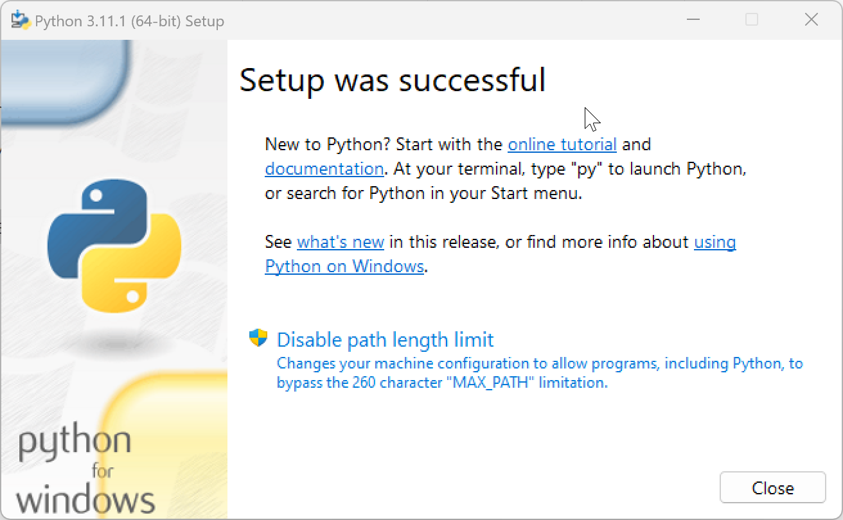
Installing Python

Slide 5
Installing Your IDE
Recommended options:
Visual Studio 2022 Community Edition
Visual Studio Code
Pycharm (JetBrains)
Professional Edition
Student Edition

Slide 6
Installing Your IDE (Visual Studio…)
Visual Studio 2022 Community Edition
https://visualstudio.microsoft.com/vs/community/
Visual Studio Code
https://code.visualstudio.com/download

Slide 7
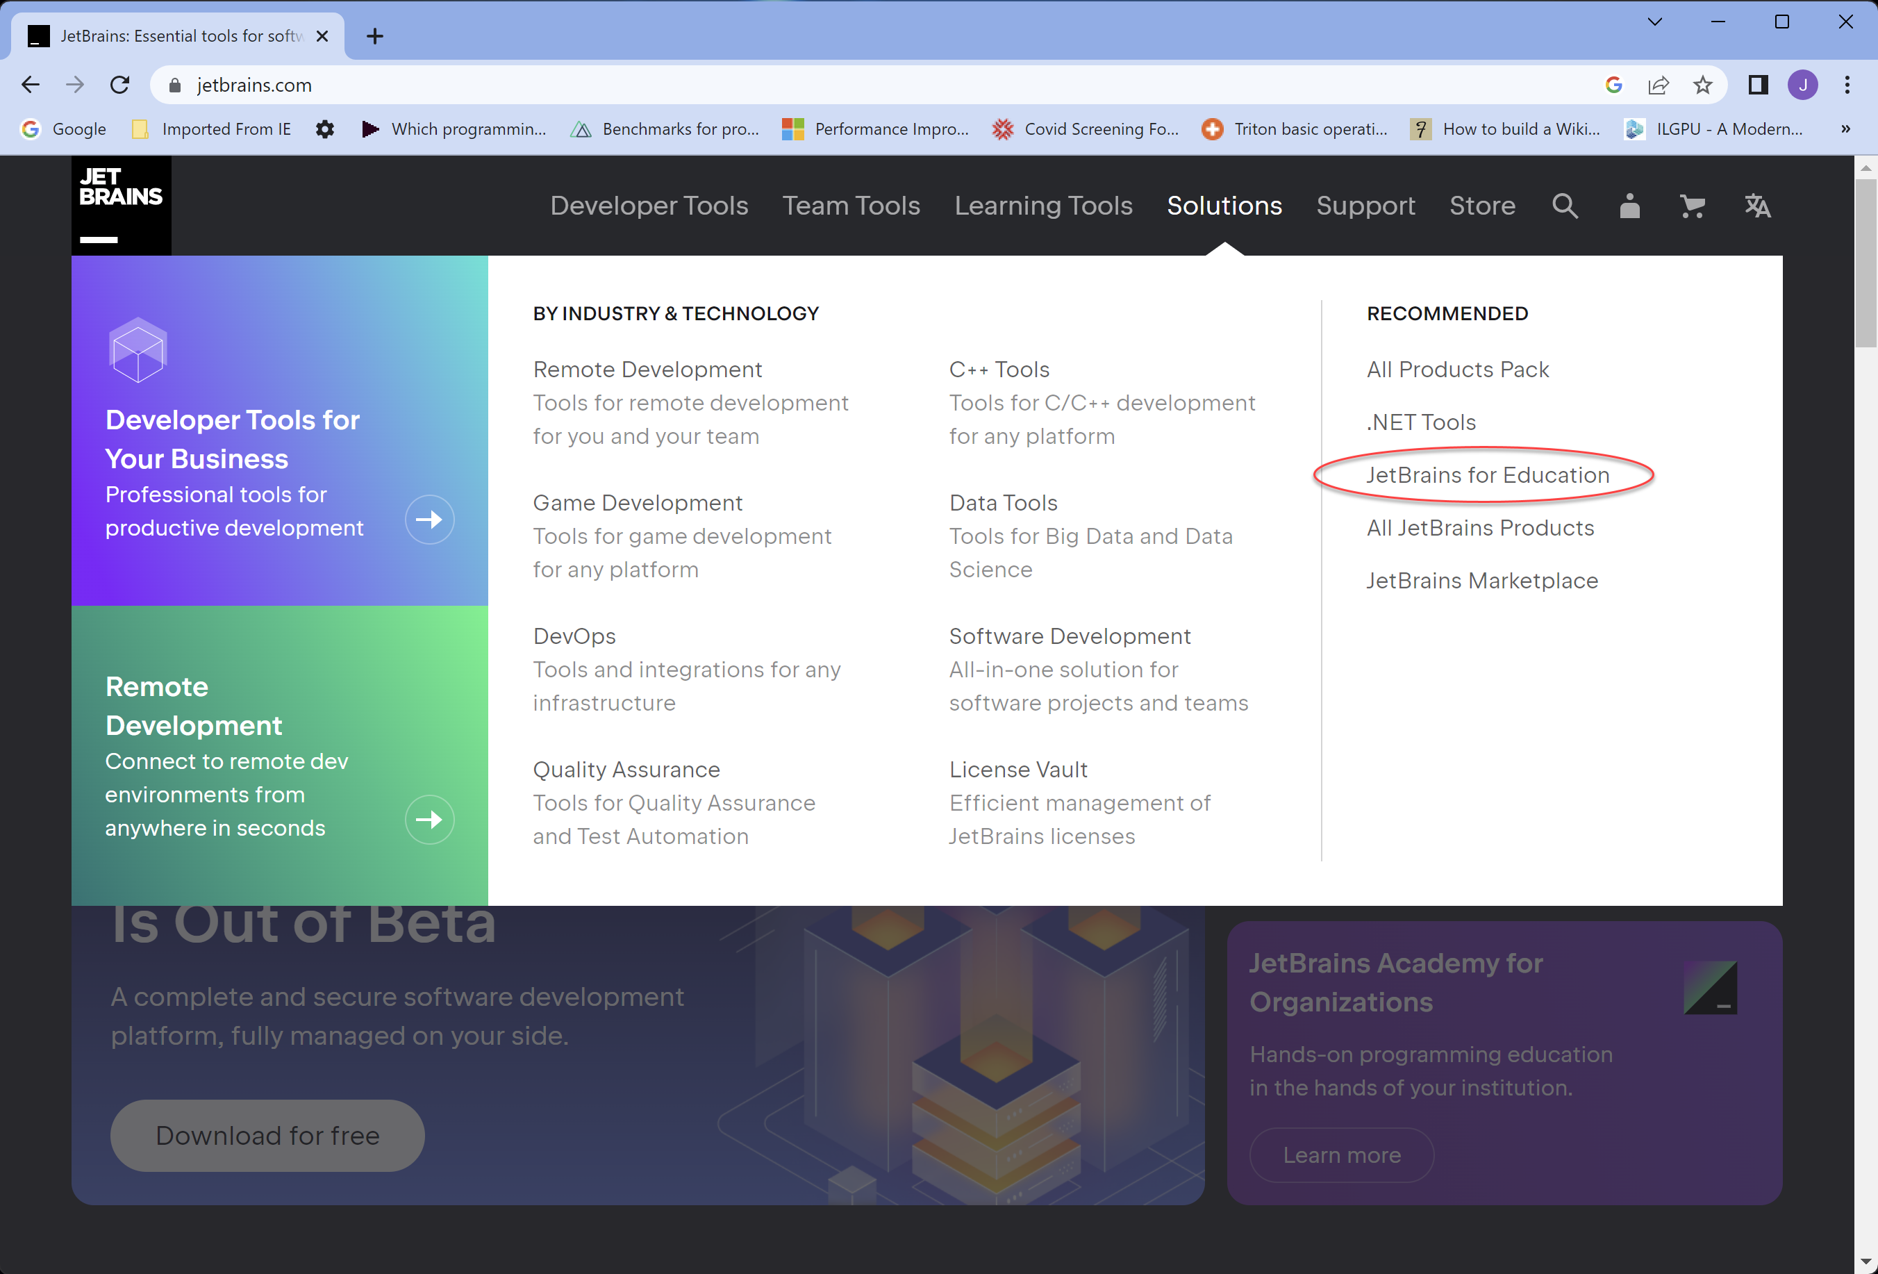
Installing Your IDE (PyCharm)

Slide 8
Installing Your IDE (PyCharm)
Or…
Licenses are available to users who log in via JetBrains Account with an email address ending in @fanshaweonline.ca, @fanshawec.ca.
https://fanshaweg2001.fls.jetbrains.com/
That’s the URL users need to enter in their product to get a license.

Slide 9
Textbook Source Code
www.manning.com/books/the-quick-python-book-third-edition
https://github.com/nceder/qpbe3e

Slide 10
Interactive Prompt
Python REPL
Read, Evaluate, Print, Loop
>>>

Slide 11
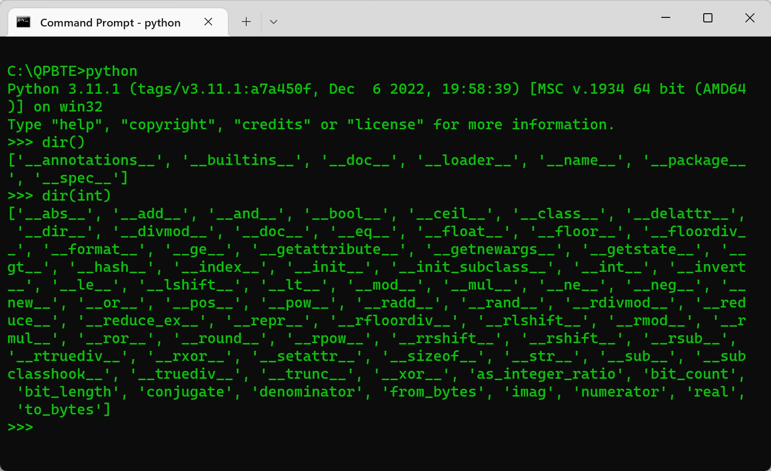
Interactive Prompt

Slide 12
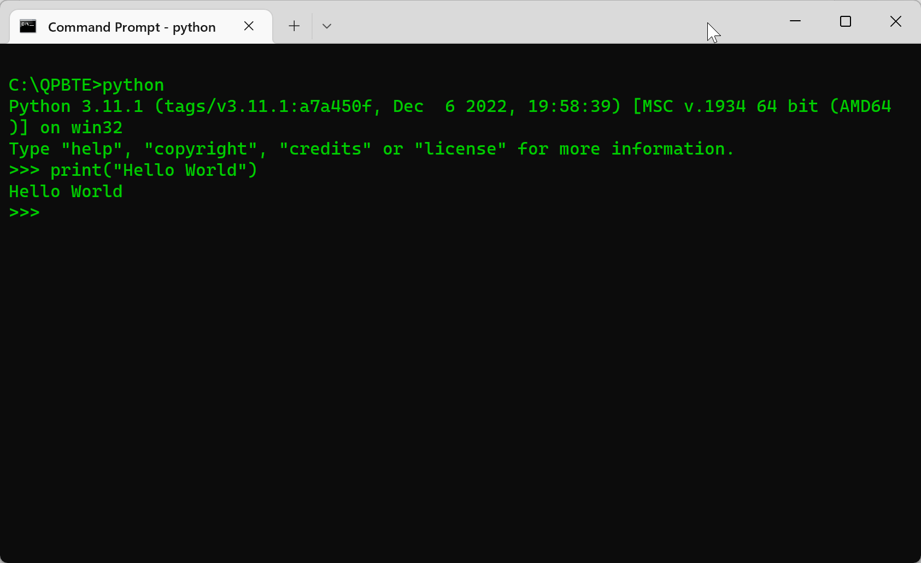
Interactive Prompt
>>> print("Hello, World")
Hello, World

Slide 13
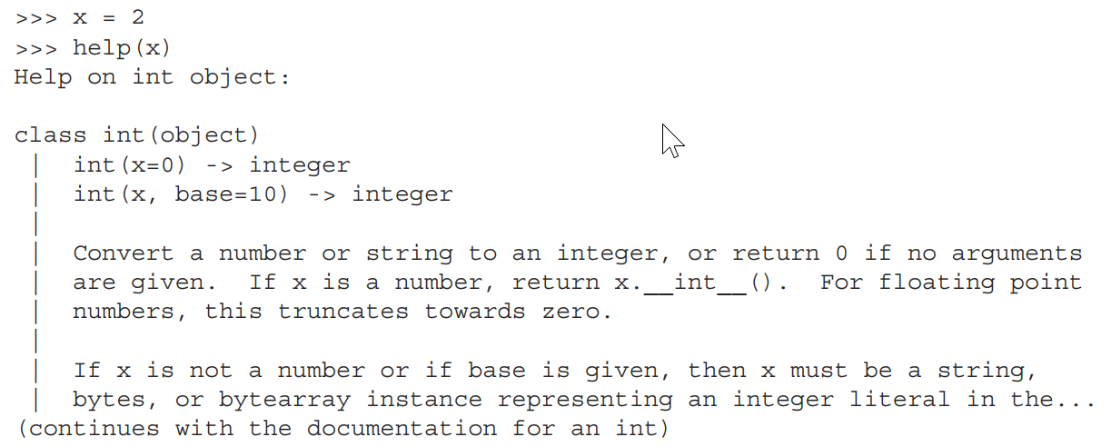
Interactive Prompt
Command line help

Slide 14
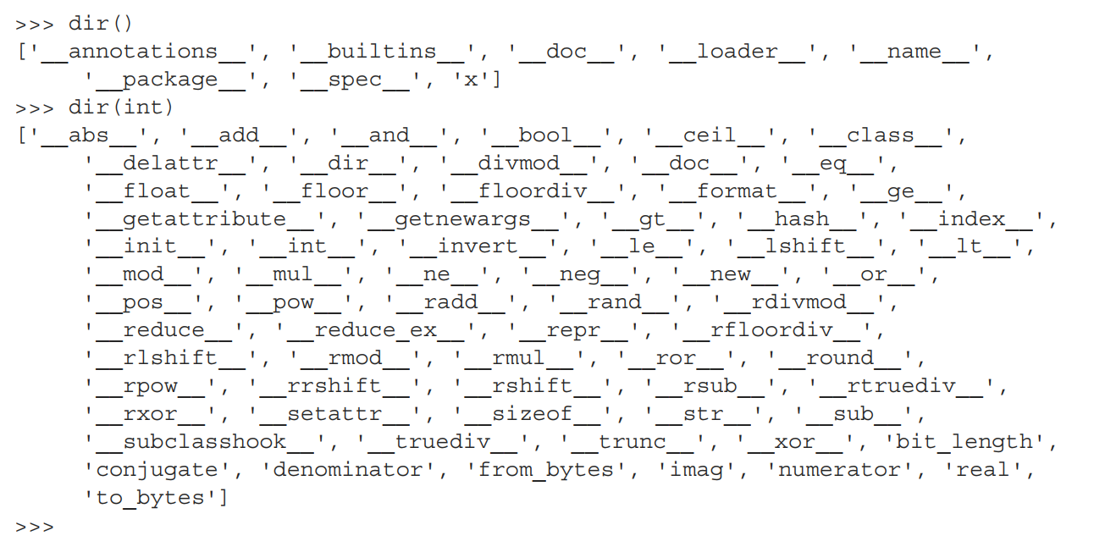
Interactive Prompt

Slide 15
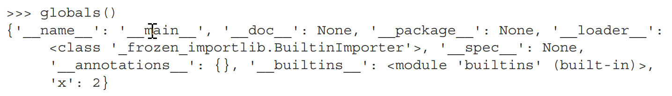
Interactive Prompt

